Slide 1
WELCOME MESSAGE

Slide 2
The Mediator Makes a Difference: Diverse Perspectives on Mediation
Presented By: Mediator Jonathan Andrews, Esq.
Katherine Djavakhyan, Senior Corporate Counsel, Google
Shondella Reed, Associate General Counsel Labor & Employment, Meta
Danielle Ochs, Shareholder, Ogletree, Deakins, Nash, Smoak & Stewart

Slide 3
Table of
Contents
01.
02.
PREPARATION
PARTICIPATION
Diversity in Mediation
Choosing the Right Time
Selecting the Right Mediator
Including the Right Attendees
Pre-Mediation Communication and Preparation
Strategy & Process
Expand the Resources
Mediator Proposals
Notes:
Photo by Sean Pollock on Unsplash

Slide 4
Diversity in Mediation
ABA Model Standards :
Any person may be selected as a mediator, provided that the parties are satisfied with the mediator’s competence and qualifications. Training, experience in mediation, skills, cultural understandings and other qualities are often necessary for mediator competence. A person who offers to serve as a mediator creates the expectation that the person is competent to mediate effectively
California Rules of Court state:
A mediator has a continuing obligation to assess whether or not his or her level of skill, knowledge, and ability is sufficient to conduct the mediation effectively. A mediator must decline to serve or withdraw from the mediation if the mediator determines that he or she does not have the level of skill, knowledge, or ability necessary to conduct the mediation effectively.
Notes:
California Code of Civil Procedure 664.6 to enforce settlement terms

Slide 5
01.1
PREPARATION:
Goals of Mediation

Slide 6
GOALS OF MEDIATION
Resolution
Messaging
Information
Framing Dispute

Slide 7
01.2
PREPARATION:
Choosing the Right Time

Slide 8
CHOOSING THE
RIGHT TIME
CHOOSING THE RIGHT TIME
Pre-Dispositive Motions
Pre-litigation
Pre-deposition
Pre-Trial
Notes:
Photo by Sean Pollock on Unsplash

Slide 9
01.3
PREPARATION:
Selecting the Right Mediator

Slide 10
CHOOSING THE
RIGHT MEDIATOR
Mediator Fees
Judge
Attorney
Agencies
Notes:
Signature Resolution; Judicate West; JAMS, ADR Services
Photo by Sean Pollock on Unsplash

Slide 11
01.4
PREPARATION:
Selecting the Right Attendees
Notes:
Requirements for decisionmaker to participate; fact witnesses v. declarations

Slide 12
SELECTING THE RIGHT ATTENDEES
AUTHORITY TO SETTLE
FACT WITNESSES
DECLARATIONS
EXPERT WITNESSES
Notes:
Cost of experts; federal judge requirements of attendance; telephonic vs. personal appearance

Slide 13
01.5
PREPARATION:
Pre-Mediation Communication & Preparation

Slide 14
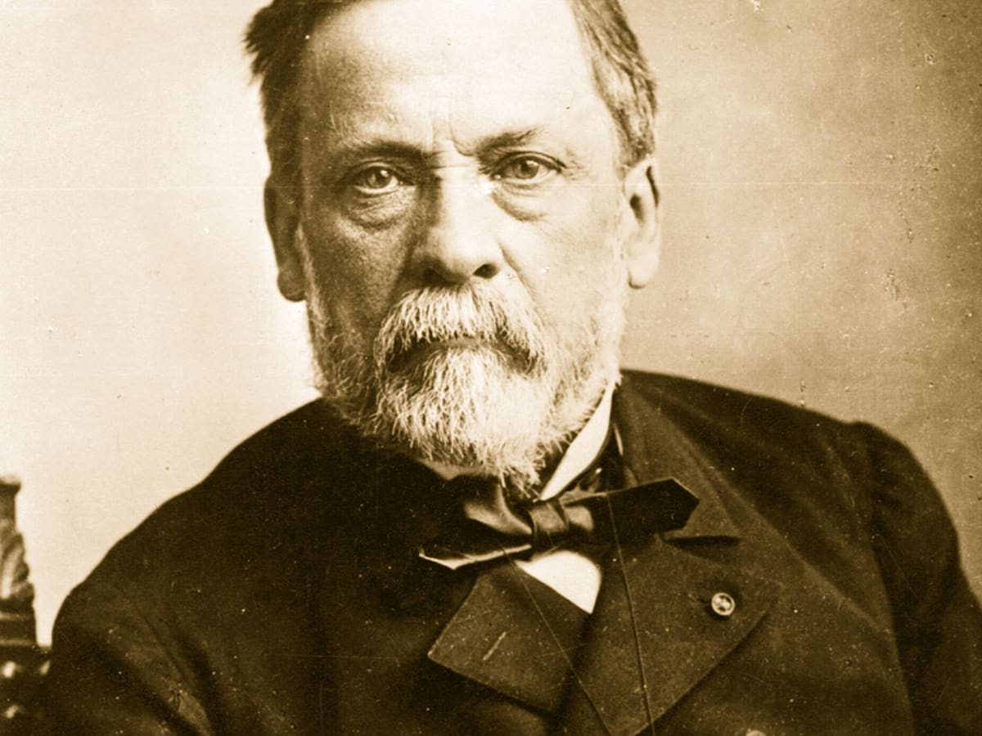
“Chance favors the prepared mind.”
a
-Louis Pasteur

Slide 15
PRE-MEDIATION ASSESSMENT
Clear sense of potential liability and damages
Settlement authority
Pre mediation demand
In-house counsel wish list
Notes:
Damages and fees to date are often objective
What information is needed to get a sense of potential liability?
Photo by Sean Pollock on Unsplash

Slide 16
02.1
PARTICIPATION:
Strategy & Process

Slide 17
STRATEGY & PROCESS
Sticking with the plan
Integrative bargaining
Ethical negotiating
Incorporating the mediator
Power moves – dealing with a difficult opponent
Partnering with the mediator
Bracketing
Notes:
Photo by Sean Pollock on Unsplash

Slide 18
Ethical Negotiating
Rules of Professional Conduct 4.1/ABA Model Rule 4.1
“[A] lawyer shall not knowingly make a false statement of material fact or law to a third person”
“A lawyer is required to be truthful when dealing with others on a client’s behalf, but generally has no affirmative duty to inform an opposing party of relevant facts”
Estimates of price or value placed on the subject of a transaction and a party’s intentions as to an acceptable settlement of a claim are ordinarily not material statements of fact
Notes:
Under 4.1 whether a particular statement should be regarded as one of fact can depend on the circumstance
Business and Professions Code section 6106 and rule 8.4

Slide 19
Power Moves – Dealing With A Difficult Opponent
Walkaways
"Best & final”
Increasing demands
Threats (past verdicts, excessive discovery, etc.)
Policy demand
Client control issues
Notes:
Photo by Sean Pollock on Unsplash

Slide 20
02.2
PARTICIPATION:
Expand the Resources

Slide 21
EXPANDING THE RESOURCES
Outplacement
Rehire (disability cases)
Donations
Unemployment
COBRA
Training
Keeping equipment
Apology
Structured settlements
Mediator fees

Slide 22
02.3
PARTICIPATION:
Mediator Proposals
Notes:
Unsolicited vs. Solicited
Critical Terms
Timing

Slide 23
QUESTIONS?

